Slide 1
Developing SharePoint Server Advanced Solutions
Working with Business Connectivity Services

Slide 2
Working with Business Connectivity Services Overview
Creating BDC Models
Creating External Content Types
Working with External Events and Notifications

Slide 3
2 BDCs – 1 BCS
Business Data Catalog, predecessor to Business Connectivity Services in SharePoint 2007
Business Data Connectivity was introduced with Business Connectivity Services in SharePoint 2010

Slide 4
BDC Model
External System
External Content Type
External List
External Data Column
Business Data Connectivity (for Office)

Slide 5
Demonstration: Creating and Consuming an External Content Type
In this demonstration you will see how to:
Create an external content type in SharePoint Designer
Create an external list in SharePoint Designer
Set permissions on an external content type in Central Administration
Browse data in an external list

Slide 6
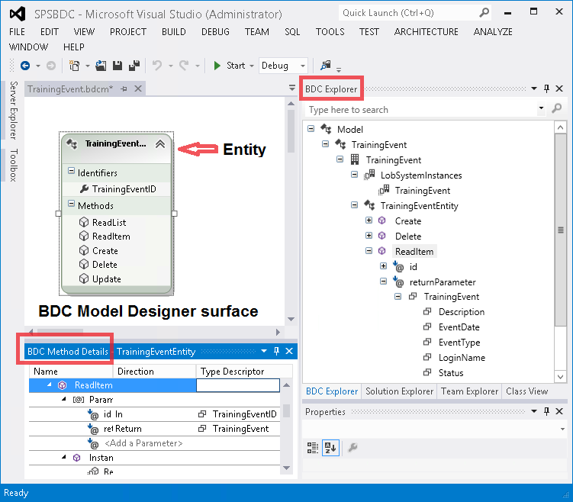
Using the BDC Model Designer

Slide 7
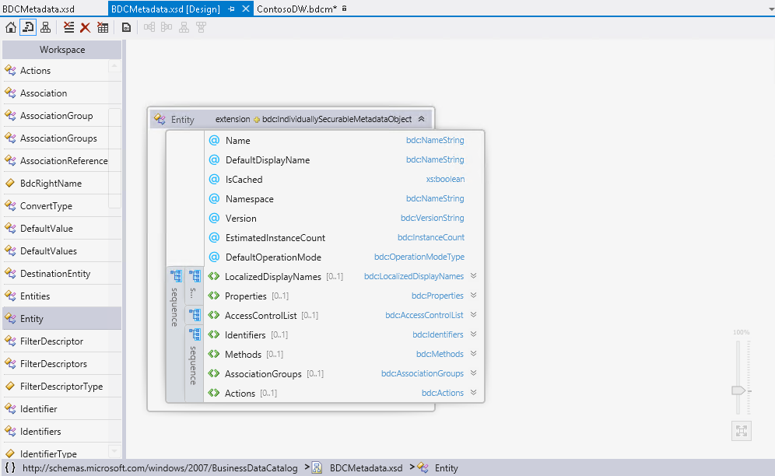
BDC Model Files and Schema

Slide 8
BDC Model Files and Schema 2
Sample method used to retrieve a single item:
<Method IsStatic="false" Name="DimEmployeeReadItem">
<Properties>
<Property Name="RdbCommandType">Text</Property>
<Property Name="RdbCommandText" Type="System.String">SELECT [EmployeeKey], [FirstName], [LastName] FROM [dbo].[DimEmployee] WHERE [EmployeeKey] = @EmployeeKey</Property>
<Property Name="BackEndObjectType" Type="System.String">SqlServerTable</Property>
<Property Name="BackEndObject" Type="System.String">DimEmployee</Property>
<Property Name="Schema" Type="System.String">dbo</Property>
</Properties>
<AccessControlList>…</AccessControlList>
<Parameters>…</Parameters>
<MethodInstances>…</MethodInstances>
</Method>

Slide 9
Demonstration: Connecting to OData Source
In this demonstration you will see how to:
Create an external content type in Visual Studio
Deploy to SharePoint as an App
View OData External List in browser

Slide 10
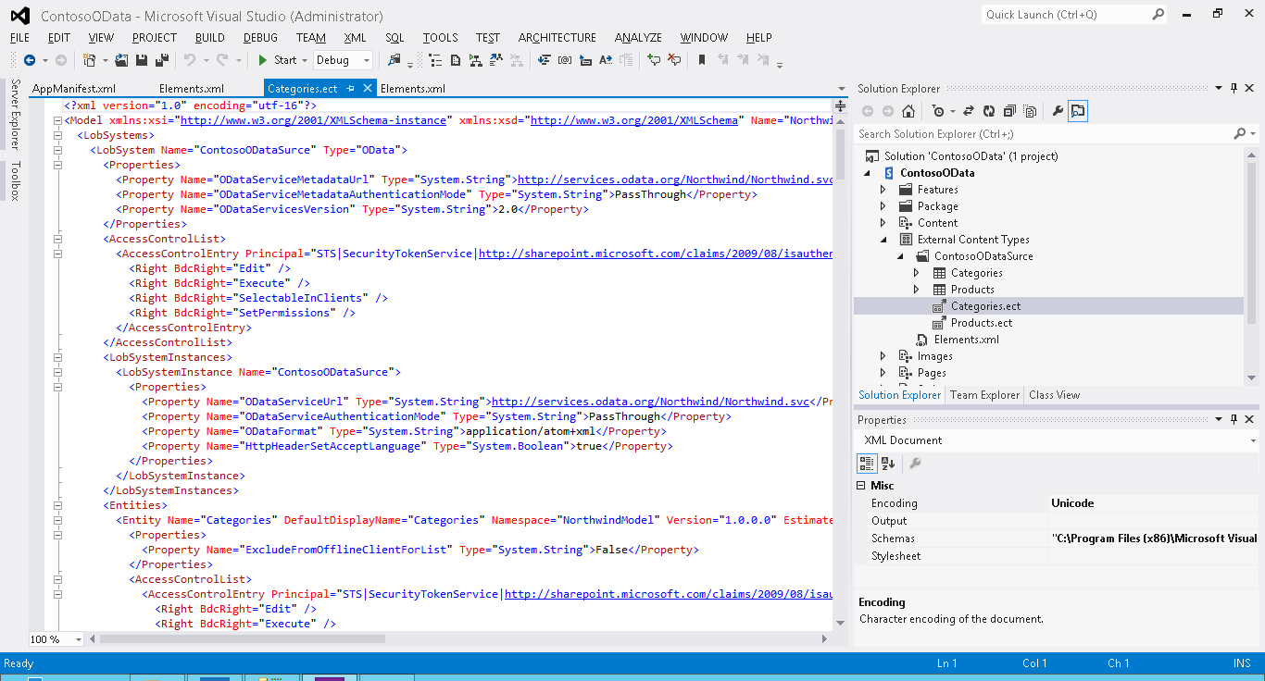
Connecting to OData Sources

Slide 11
Creating External Lists from App-Scoped BDC Models
Automatically created by OData connector
Manually created by editing element.xml for a custom list instance
<?xml version="1.0" encoding="utf-8"?>
<Elements xmlns="http://schemas.microsoft.com/sharepoint/">
<ListInstance Url="Lists/Territories" Description="Territories" OnQuickLaunch="TRUE" Title="Territories">
<DataSource>
<Property Name="LobSystemInstance" Value="ContosoODataSurce" />
<Property Name="EntityNamespace" Value="NorthwindModel" />
<Property Name="Entity" Value="Territories" />
<Property Name="SpecificFinder" Value="ReadSpecificTerritory" />
<Property Name="MetadataCatalogFileName" Value="BDCMetadata.bdcm" />
</DataSource>
</ListInstance>
</Elements>

Slide 12
Lesson 3: Working with External Events and Notifications
Event and Notification Features Enabling External System Events BCS Events Feature Implementing BDC Event Methods Initiating Subscriptions External List Event Receivers

Slide 13
Event and Notification Features
SharePoint 2010 External lists did not support alerts or event receivers
New SharePoint 2013 stereotyped operations allow external lists to participate in notification features of SharePoint
Alerts
Event Receivers
Remote Event Receivers

Slide 14
Enabling External System Events
External system must provide subscription support
OData would provide a Subscribe and Unsubscribe HTTP method
Database model would provide a Subscribe and Unsubscribe stored procedures
External system must be record subscription data
Example: DeliveryAddress, EntityName, Columns, User
When data changes, it is responsibility of external system to notify SharePoint of changes
Same event may trigger multiple subscription notifications
Response message format must be an Atom feed response

Slide 15
BCS Events Feature
BCS Event Support requires a hidden list to be created to keep track of subscriptions
“External Subscriptions Store” list stored in _private\ExtSubs folder
Enabled by activating the ExternalSubscriptions web feature

Slide 16
Implementing BDC Event Methods
BDC Model has been extended to have two new stereotypes methods
EventSubscriber, EventUnsubscriber
Special properties drive the method behavior
IsDeliveryAddress, IsEventType, IsOnBehalfOfField, SubscriptionIdName
OData method type requires specific properties to drive information exchange
ODataEntityUrl, ODataHttpMethod, ODataPayloadKind
Three Message Response Parsers
Identity, ODataEntryContent, Custom
Identity is default if none specified

Slide 17
Initiating Subscriptions
Subscriptions can be created explicitly or implicitly
Explicit calls are made via the entity’s subscribe method
Implicit calls are made when alerts or event receivers are created
Conversely, a subscription can be removed explicitly or implicitly
Explicit is made via entity’s unsubscribe method
Implicit is called when an alert or event receiver is removed

Slide 18
External List Event Receivers
Once subscription methods are configured you can place event receivers on your external lists
ItemAdded, ItemUpdated and ItemDeleted are only supported events
A new property of the SPItemEventProperties class is ExternalNotificationMessage
Contains the encoded message that was sent from the external system
Convert the message to a string and analyze the external event changes
Encoding.UTF8.GetString

Slide 19
References
SharePoint 2013 changes and features in Business Connectivity Services, Microsoft.com video 7/16/12
Make Business Data Available in SharePoint 2013, video, Pluralsight, 4/10/2013

Slide 20
Microsoft Press Books
SharePoint 2013 Inside Out
Chapter 22
Microsoft SharePoint 2013 : Developer Reference
Chapters 10 and 14
Inside SharePoint 2013
Chapter 16

Slide 21
Module Review and Takeaways
You learned
How to Create a BDC Model, External Content Type and External List – 2 ways
What’s Changed in Events and Alerts with BCS in 2013
How BCS Events are Implemented

